Slide 1


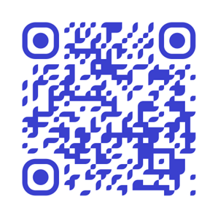
New Employee Benefits Webinar
Welcome! Today hear from MOSERS, MO Deferred Comp, MCHCP, and MO Café.

Slide 2
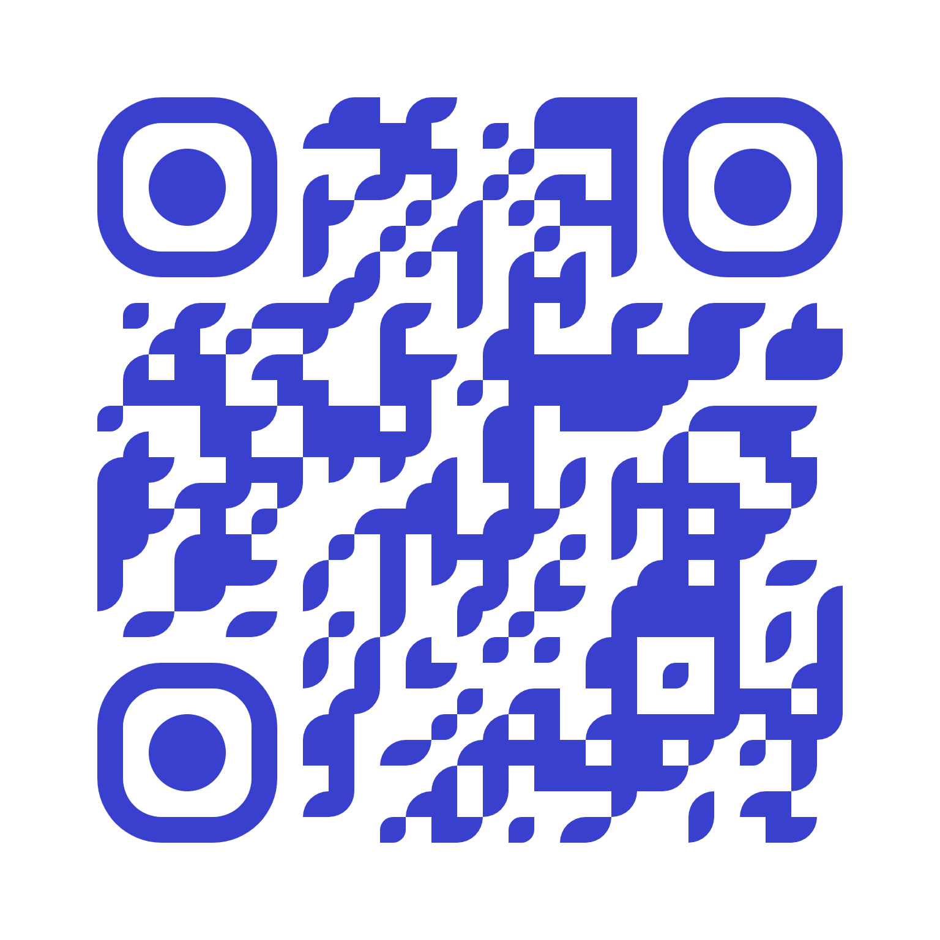

MOVLIC
Universal life insurance provides flexible coverage with the added benefit of fund value growth, earning tax-deferred interest. You can adjust premium payments, and coverage amounts to meet your changing needs. Costs are deducted monthly, and you can decrease, skip, or stop payments if there’s enough fund value to cover premiums. You can take this coverage with you if you were to ever leave the state!
Eligibility:
Active employees working at least 20 hours per week.
Coverage is also available for your spouse, children, and grandchildren.
Questions? Contact:
MOVLIC
  Call: 866-668-5421
  Email: movlic@mhgins.com

Slide 3
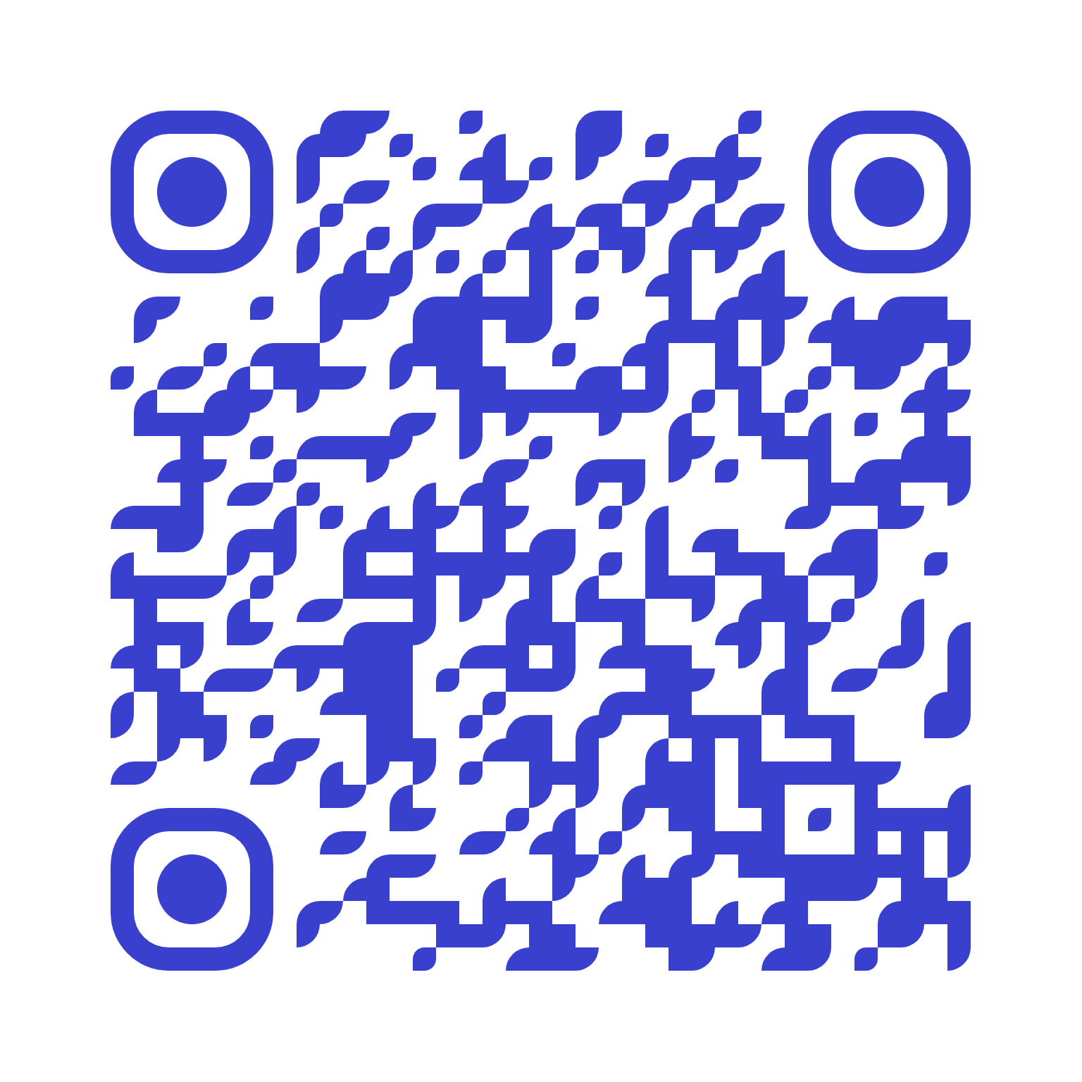
Missouri’s 529 Plan: A Smart Start for Education Savings
A 529 plan is a tax-advantaged investment account designed to help families save for education expenses, from K-12 tuition to college and beyond.
Easy to Begin: No minimum investment required, every dollar counts!
Tax Benefits: Grow your savings tax-free and get a Missouri state tax deduction.
Flexible Investment Options: Choose from trusted providers like Vanguard and DFA.
Use for Many Schools: Pay for college, trade schools, and apprenticeships or even K-12 tuition.
Want to learn more? Join MOST 529 on the first Tuesday of every month for an informational session, join a meeting!
Questions? Contact:
888-414-6678
MOST 529

Slide 4
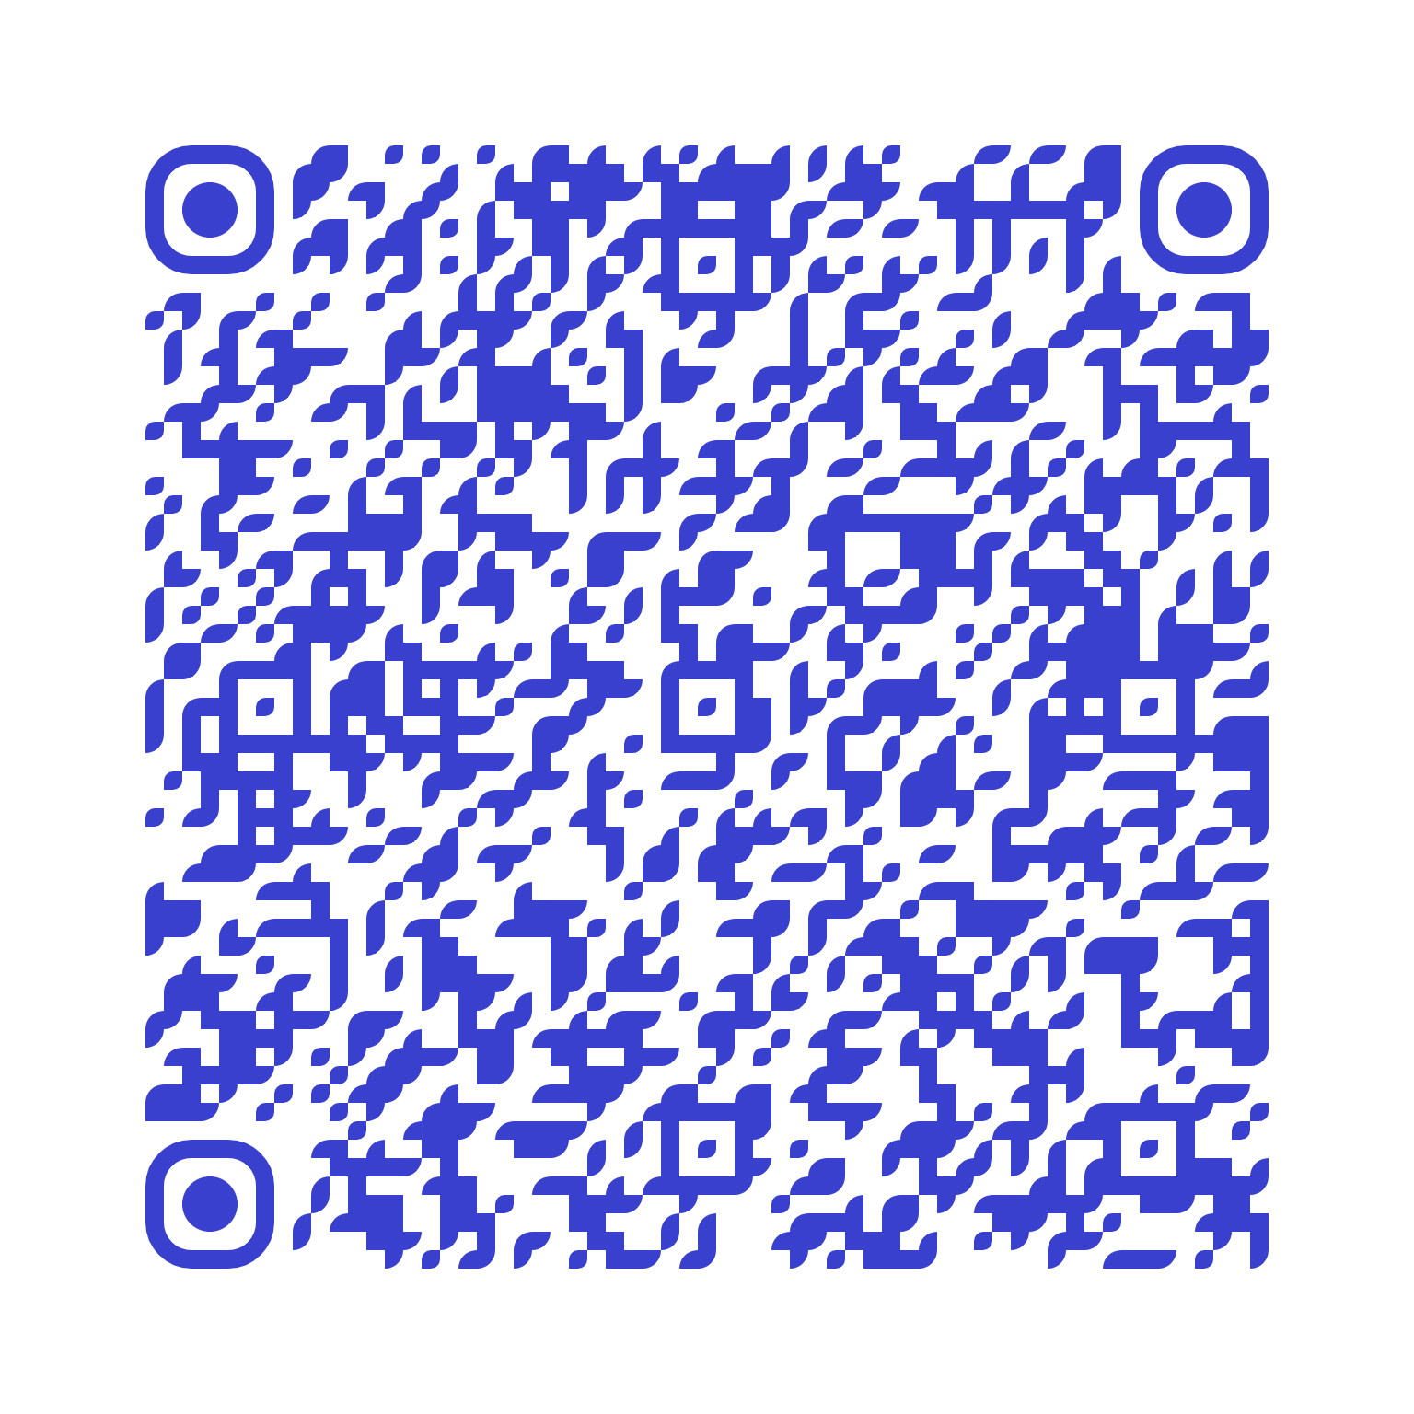
The Discount Hub
Explore the State of Missouri Discount Hub, your one-stop destination for exclusive discounts on hotels, travel, amusement parks, and more! Whether you’re planning a getaway, looking for family entertainment, or shopping for everyday deals, you’ll find a variety of savings to make the most of your budget. Don’t miss out on these special offers available only to Missouri team members!
Visit the MO Benefits Website to learn more!
https://mobenefits.mo.gov/resources/

Slide 5
Educational Benefits
The MU Career Accelerator, offered by the University of Missouri Extension, provides a 10% discount for State Employees on any Pathway Certificate Program.
Flexible Online Learning, complete a certificate in 6-10 months with fully online, self-paced courses.
Choose from programs like Public Management, Construction Management, and Supply Chain Management to boost your skills!
Columbia College offers a 15% tuition discount for State of Missouri employees and their spouses/domestic partners and dependents under 25.
At Columbia College, there are no additional educational fees, no book costs, no surprises, and every student has access to individualized support from dedicated Student Success Coaches.
Want to learn more? Visit: https://mobenefits.mo.gov/resources/

Slide 6
State Holidays
Eligible team members enjoy 13 paid holidays annually. Please note that holiday availability may vary by department, and not all team members are guaranteed these days off. Check with your supervisor to determine your specific holiday schedule.
New Year’s Day | Independence Day
Martin Luther King, Jr’s Birthday | Labor Day
Lincoln’s Birthday | Columbus Day
Washington’s Birthday | Veteran’s Day
Truman Day | Thanksgiving Day
Memorial Day | Christmas Day
Juneteenth

Slide 7
MOBenefits: Helping Team Members Thrive
MO Benefits: Your Monthly Resource for Maximizing Benefits
The MO Benefits newsletter is sent out each month, helping team members learn about their benefits and stay informed. Each issue covers important topics like health insurance, retirement, and financial wellness.
Monthly Lunch and Learns: Join us every month for sessions to dive deeper into specific benefit topics.
Stay Informed: Explore new ways to take advantage of the benefits available to you and your family.
Make the most of your benefits with MO Benefits!
Explore More At:
https://mobenefits.mo.gov/#events-section

Slide 8
Additional Questions? Reach Out to a Benefit Provider Today!
MOSERS
MO Deferred Comp
MCHCP
  Call: 800-827-1063
  Email: mosers@mosers.org
  Call: 800-392-0925
  Email: modeferredcomp@modeferredcomp.org
  Call: 800-487-0771
  Website: mchcp.org
MO Cafe
MO Benefits
  Call: 800-659-3035
  Email: asi@asiflex.com
  Email: MoBenefits@oa.mo.gov
  Website: https://mobenefits.mo.gov/

