Slide 1
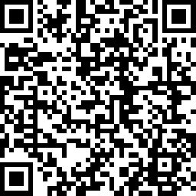
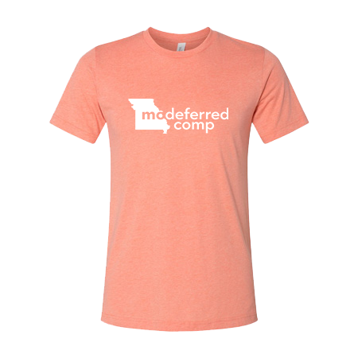
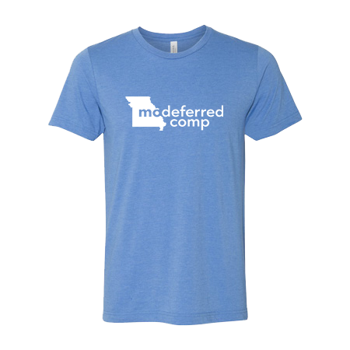
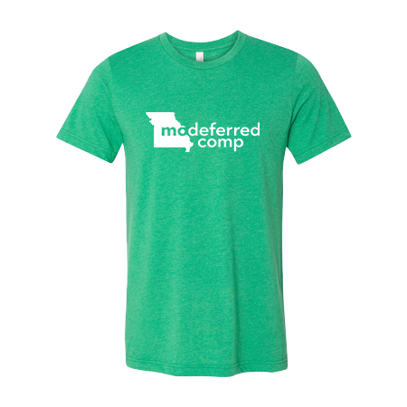
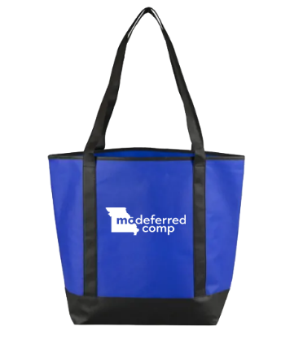
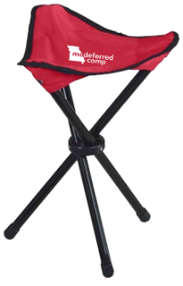

While you wait, please help out MO Deferred Comp by answering this short 3-minute investment education survey.
Welcome to The Essentials presentation!
Your participation will help us to create and deliver effective top tier investment and financial education.
You will also be entered to win a MO Deferred Comp T-shirt and/or other Goodies
Scan this code to take the survey!

Slide 2


The Essentials
Retirement Savings Simplified

Slide 3



Your State Retirement Benefits
Defined Benefit Pension Plan
Guaranteed retirement income for life provided by MOSERS or MPERS
Benefit based on a formula set by legislation
Defined Contribution Plan
Based on your contributions to the plan & your investment returns
Portable upon leaving the state

Slide 4

MO Deferred Comp Basics
The MO Deferred Comp Plan is a voluntary defined contribution 457(b) plan that helps state employees save for the future and can provide another source of income in retirement.
The plan was established by law in 1974.
Participation in deferred comp is voluntary.
Over 85% of state employees save with the plan.
New employees automatically contribute 1% pre-tax per paycheck to their deferred comp account.¹
You have the option to contribute a flat-dollar or a percent of your pay.
Pre-tax and after-tax (Roth) savings options are available.
You can withdraw your 457 contributory source funds, penalty-free, after you leave the state.
The State of Missouri will match qualified contributions, up to a maximum of $75 each month, for most state employees.
¹ Employees FIRST hired on or after July 1, 2012, are automatically enrolled into the MO Deferred Comp Plan and contribute 1% per paycheck, unless they make changes to their account. Automatic enrollment excludes universities and previous temporary or seasonal non-benefit eligible employees.
Notes:
The State of Missouri offers a supplemental Defined Contribution plan called the State of Missouri Deferred Compensation Plan. This is a plan that allows state of Missouri employees to voluntarily save additional money for their retirement. Contributions to the deferred compensation plan can be contributed either as a pre-tax contribution or as an after-tax contribution referred to as a Roth. The deferred compensation plan offers employees flexibility to save according to what they determine their retirement income needs to be.

Slide 5
Get matched, starting today!
If you contribute at least $25 a month to your MO Deferred Comp account, the State of Missouri will match your contributions dollar-for-dollar up to a maximum of $75 each month.
For active part-time or full-time state agency employees. College and university employees are not eligible.
Funded by the State of Missouri and is subject to the approval of the state’s annual budget.
Your Monthly Contribution | Monthly State Match | Total Monthly Contribution | Balance in 10 Years* | Balance in 25 Years*
$20.00 | $0.00 | $20.00 | $3,278.00 | $13,850.00
$25.67 | $25.67 | $51.34 | $8,414.00 | $35,578.00
$50.89 | $50.89 | $101.78 | $16,680.00 | $70,533.00
$75.00 | $75.00 | $150.00 | $24,582.00 | $103,949.00
$104.56 | $75.00 | $179.56 | $29,426.00 | $124,434.00
$302.00 | $75.00 | $377.00 | $61,783.00 | $261,259.00
*Assumes 6% annual return.
*Assumes 6% annual return.

Slide 6
Pre-Tax vs. After-Tax (Roth)
Which option is right for you?
 | Pre-Tax | After-Tax (Roth)
Contributions | Pre-tax contributions are typically made, if: You assume you will be in a lower tax bracket in retirement You want to reduce your current taxable income and would rather pay income taxes on the money in retirement | Roth contributions are typically made, if: You assume you will be in a higher tax bracket in retirement, or You simply want to pay income taxes up front
Auto-enrollment | New employees* are auto-enrolled at a 1% contribution. | New employees are NOT auto-enrolled into Roth.
Match | YES, if you meet the qualifications. | YES, if you meet the qualifications.
Withdrawals | Must be separated from employment Pre-tax assets are taxed as ordinary income. IRS requires an immediate 20% withholding; some exceptions may apply. | Roth withdrawals are tax-free, if: Separated from employment Five years have passed since January 1 of the year of your first Roth contribution AND you are at least 59½ There can be exceptions for disability or death Roth earnings may be 100% tax-free. That’s huge!

Slide 7

Max-out your retirement savings.
2026 IRS Contribution Limits*
Contribution Limit | Amount
Maximum Annual Deferral – under age 50 | $24,500
Age 50 and Over Catch-Up Provision Limit | $8,000 ($32,500 total)
Age 60-63 Catch-Up Limit | $11,250 ($35,750 total)
Pre-Retirement Catch-Up Provision Limit If you are within 3 years of normal retirement eligibility One-Time 3-year period Must file paperwork | $24,500 ($49,000 total)
*These contributions do not affect Individual Retirement Account (IRA) contributions.

Slide 8


A rollover allows you to move retirement funds from one retirement account to another, as you change jobs, without incurring tax consequences.
What types of retirement saving accounts can I roll into deferred comp?
Traditional IRA, and pre-tax or designated Roth 401(k), 403(b), & 457(b)
BackDROP
Roth IRA assets cannot be rolled into a 457 plan
Rolling in designated Roth assets may affect your qualified (tax-free) distribution eligibility date
Why should you roll money into deferred comp?
Easier to manage (single vs. multiple accounts)
Low-cost, custom investment options
24/7 Online Account Access
How do you roll money over?
Complete the Rollover Contribution Form and submit all required documentation.
Reminder: Contact your previous employer to find out their process and time frame for completing the rollover.
Notes:
You may rollover eligible before-tax distributions to the plan from qualified retirement plans, 401(a) plans, 401(k) plans, 403(b) plans, governmental 457 plans, traditional IRAs and BackDROP funds from MOSERS or MPERS.
You may also roll into the plan after-tax (Roth) contributions from other 457, 401(k), or 403(b) plans that accept and provide recordkeeping for Roth assets. Roth IRA assets cannot be rolled to a 457 plan.
Question for attendees: What is something you have noticed that has drastically increased in price this past year? Do not state the obvious….gas.

Slide 9
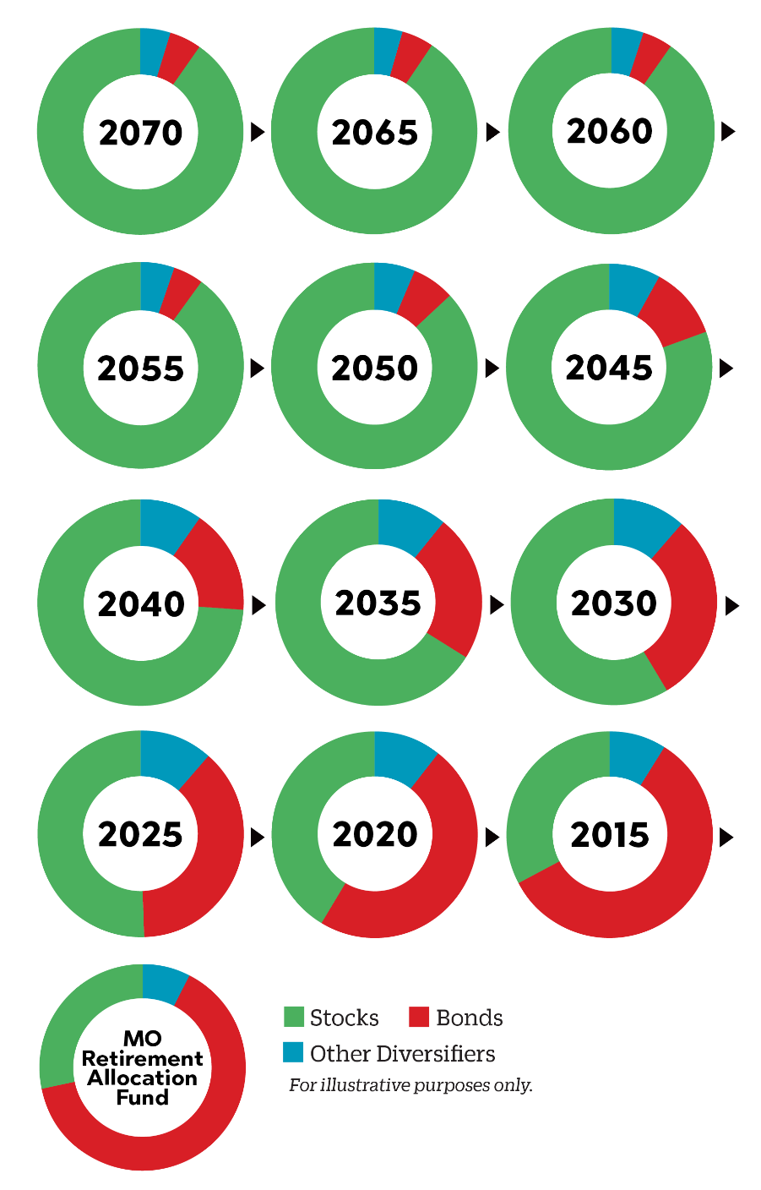
Investment Options
01. Missouri Target Date Funds
13 target date funds
Each fund contains a mix of stocks, bonds, and other investments
Funds automatically rebalance over time
02. Missouri Stable Income Fund
A fixed-income, lower interest rate investment option
Seeks to protect your principal balance
Potential for steady growth over time without daily market fluctuations
Rate resets quarterly
03. Self-Directed Brokerage Account
For hands-on-investors
Ability to build your own investment portfolio
Access to most individual stocks and bonds, and more than 13,000 mutual funds
Charles Schwab

Slide 10

Bringing it all together.
How much should you save for retirement?
As a state of Missouri employee, your income in retirement will come from three primary sources: your defined benefit pension from either MOSERS or MPERS, social security, and your personal savings.
Years of MO State Employment
FACT:
There’s a good chance, your pension and social security won’t be enough.
Assumes normal retirement and a single life annuity from MOSERS or MPERS 2000 & 2011 defined benefit pension plans. The social security percentage is based on the average income replacement if taken at approximately age 62. Social Security replacement income will vary based on when you choose to receive social security benefits (whether as early as age 62 or your full social security retirement age) and Social Security’s ability to pay 100% of scheduled benefits. For a more accurate calculation of expected benefits and income replacement from Social Security at a specific age, please visit www.ssa.gov to view your social security statement. Current statement from the Social Security Administration: "Estimated benefits are based on current law. Congress has made changes to the law in the past and can do so at any time. The law governing benefit amounts may change because, by 2035, the payroll taxes collected will be enough to pay only about 80 percent of scheduled benefits." Subject to change periodically.
Notes:
***What do we want to use for SS? Average income replacement at 62 or 67?

Slide 11
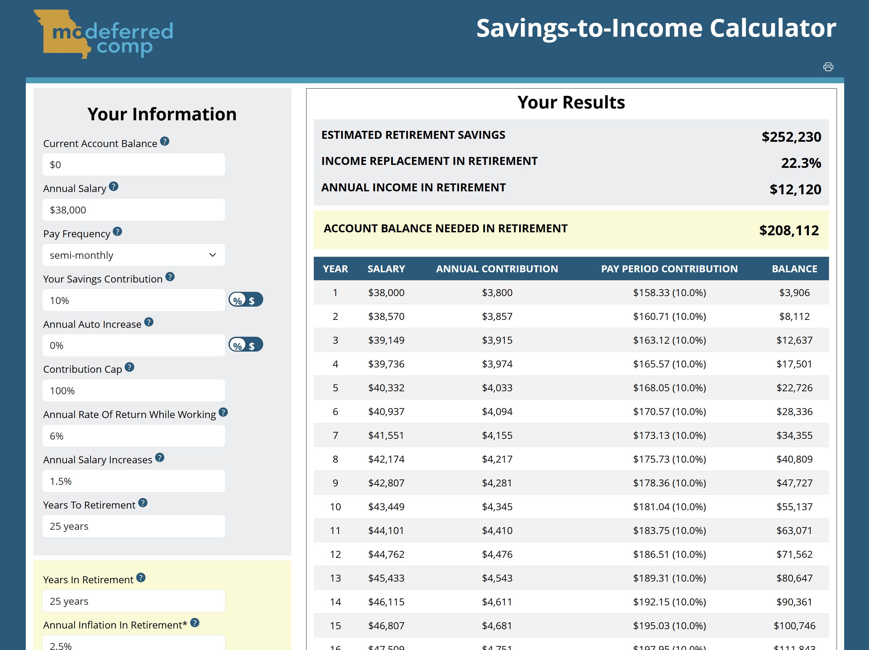
Let’s run some examples.
Use the Savings-to-Income Calculator to estimate your personal savings needs.
Visit www.modeferredcomp.org
Hover over the Resources menu item.
Click Calculators from the dropdown.
Select the Savings to Income Calculator tab.
Start estimating!
Notes:
If you save only 1% over 25 years (starting salary of $38,000), you could possibly retire with a balance of only $24,643 and replace only 2% of your income in retirement.*
*Assumes 6% return and 1.5% average annual salary increases while employed and a 4% return, 2% inflation and 25 Years in Retirement. Annual compounding and annual contribution limits will apply.

Slide 12
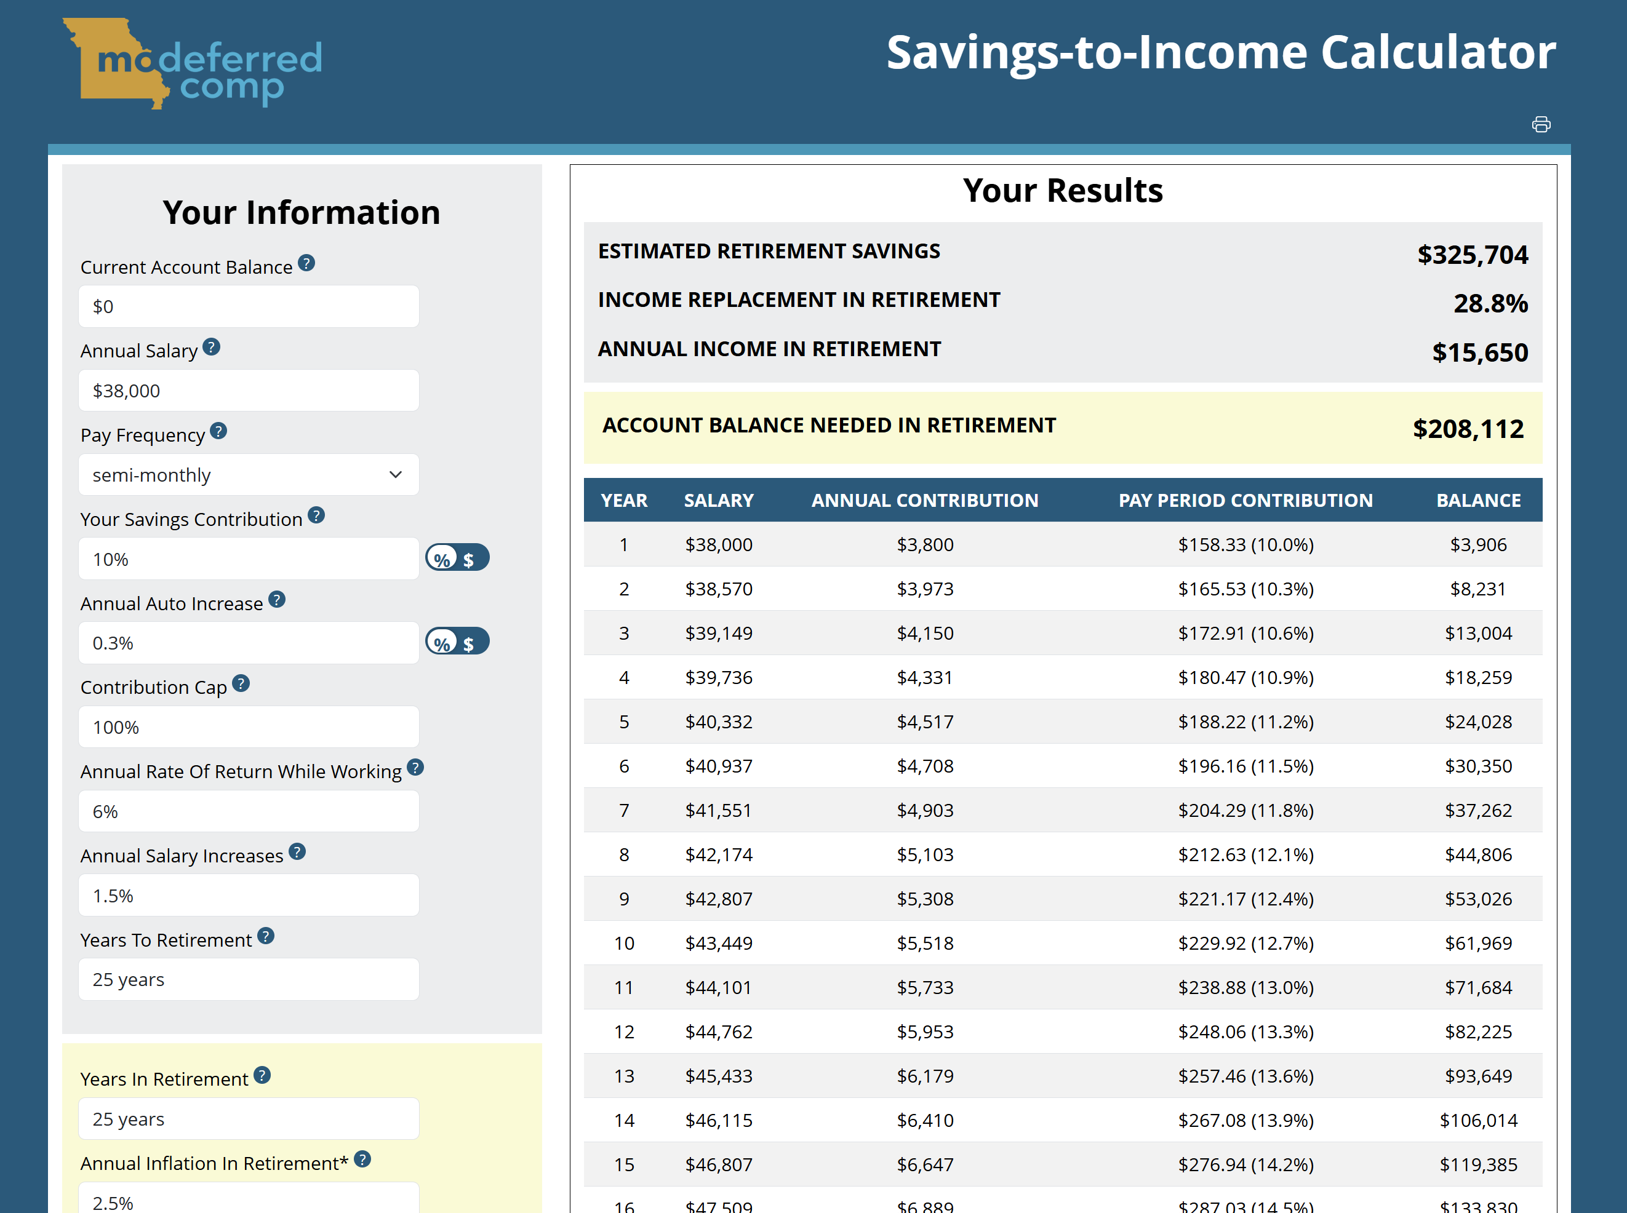
Let’s run some examples.
Use the Savings-to-Income Calculator to estimate your personal savings needs.
Check out the Annual Auto Increase feature.

Slide 13

The 2026 Saver's Credit
The Saver’s Credit is designed to help low- and moderate-income workers save for retirement by providing a dollar-for-dollar reduction on their tax bill by the amount of the credit. The maximum contribution amount that may qualify for the credit is $2,000 ($4,000 if married filing jointly), making the maximum credit $1,000 ($2,000 if married filing jointly).
Credit Rate | Married Filing Jointly | Head of Household | All Other Filers¹
50% of your contribution | AGI² of $48,500 or below | AGI² of $36,375 or below | AGI² of $24,250 or below
20% of your contribution | $48,501 - $52,500 | $36,376 - $39,375 | $24,251 - $26,250
10% of your contribution | $52,501 - $80,500. | $39,376 - $60,375 | $26,251 - $40,250
0% of your contribution | more than $80,500 | more than $60,375 | more than $40,250
¹ Single, married filing separately, or qualifying widow(er); 2 AGI = Adjusted Gross Income

Slide 14
6 Things to Do Immediately!
If you’re not already, enroll in the MO Deferred Comp Plan and start saving for retirement.
Set up your online account.
This is the easiest way to keep your account safe from hackers!
Consider saving with percent-of-pay and Roth contributions.
Be sure you’re saving enough to receive the match and use the automatic increase tool to boost your contributions each year.
Update your beneficiary information for your 457(b) & 401(a) accounts.
Log in to your account or call 800-392-0925
Your spouse must be named as primary unless a signed consent form is on file.
Schedule a meeting with your local financial education professional.
$797/month or
$402/month or
Balance at Age 65
$185/month or
AGE STARTED SAVING $100 PER MONTH
*Assumes 6% return while employed and a 4% return, 2.5% inflation and 25 years in retirement. Monthly compounding.

Slide 15

Contact the MO Deferred Comp Plan
800-392-0925
3349 American Avenue, Suite A Jefferson City, MO 65109
www.modeferredcomp.org
Voya Retire Mobile App
Available through iTunes & Google Play
Text Alerts: Text MODC to 833-437-1777

Slide 16
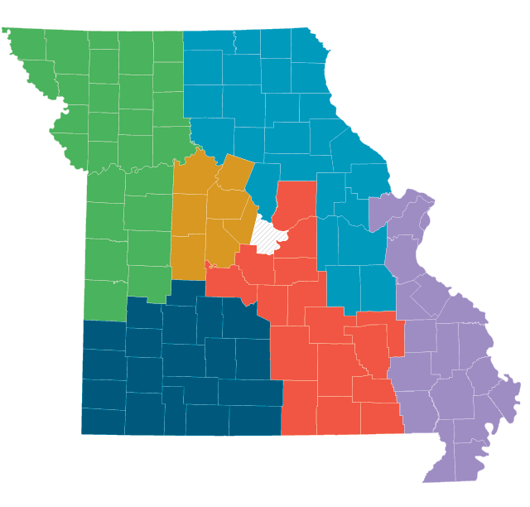
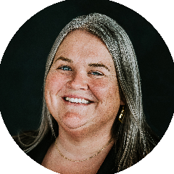

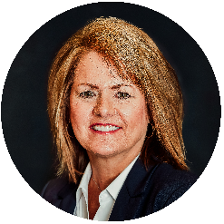



Find your local Financial Education Professional
KATE KUSE
katek@mosers.org
573-644-1266
DAVID GIBSON
davidg@mosers.org
573-644-1261
COLE COUNTY
Corrections
Economic Development
Health
Insurance
Lincoln University
Office of Administration
Revenue
Social Services
State Auditor
RONDA PETERSON
rondap@mosers.org
573-644-1264
COLE COUNTY
Conservation
Higher Education
MOSERS
MPERS
Public Safety
Secretary of State
DON WILSON
donw@mosers.org
573-644-1263
COLE COUNTY
Agriculture
Attorney General
DESE
DNR
DOLIR
Governor
Judicial
Legislature
Lt. Governor
MCHCP
Mental Health
MODOT
Public Defender
JESSE STEWART
jesses@mosers.org
573-644-1265
TAMMARA CARTER
tammarac@mosers.org
573-644-1262
Notes:
This is our crew of Financial Education Professionals covering the entire state of Missouri and all agencies. Email/call your local territory financial education professional should you want to check out additional live presentations or webinars or need to set up a 1-on-1 to get a better idea of your eventual retirement paycheck, determine what you need to do to get on the right track and complete any associated transactions.

