Slide 1




2026 Missouri State Employees’ Cafeteria Plan
Presented by: Andi Moegling, ASIFlex Senior Account Manager

Slide 2

WHAT IS A CAFETERIA PLAN?
A Cafeteria Plan is an employee benefit plan that allows employees to save money on health care and child care expenses.
Most people save at least 25% of each dollar that is set aside in the program.

Slide 3
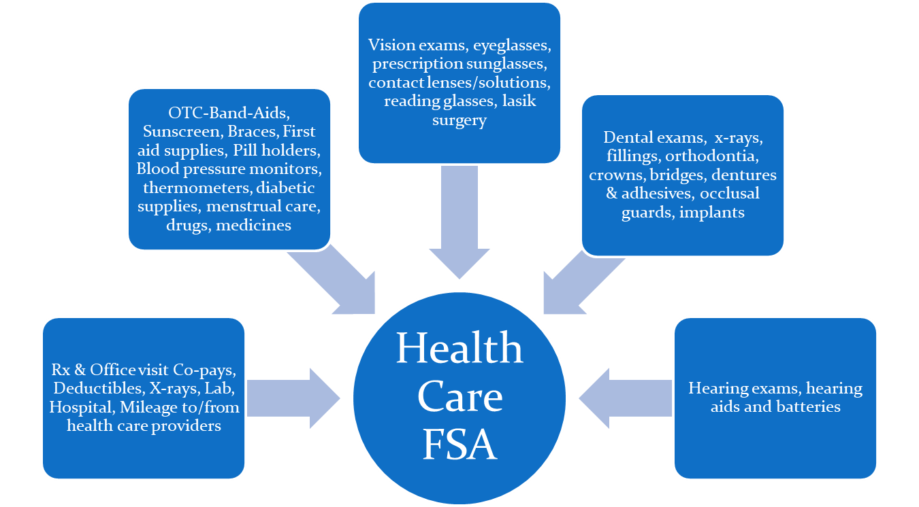
General-Purpose Health Care FSA – up to $3,300
Medical FSA
A full list of eligible expenses can be found at mocafe.com.

Slide 4
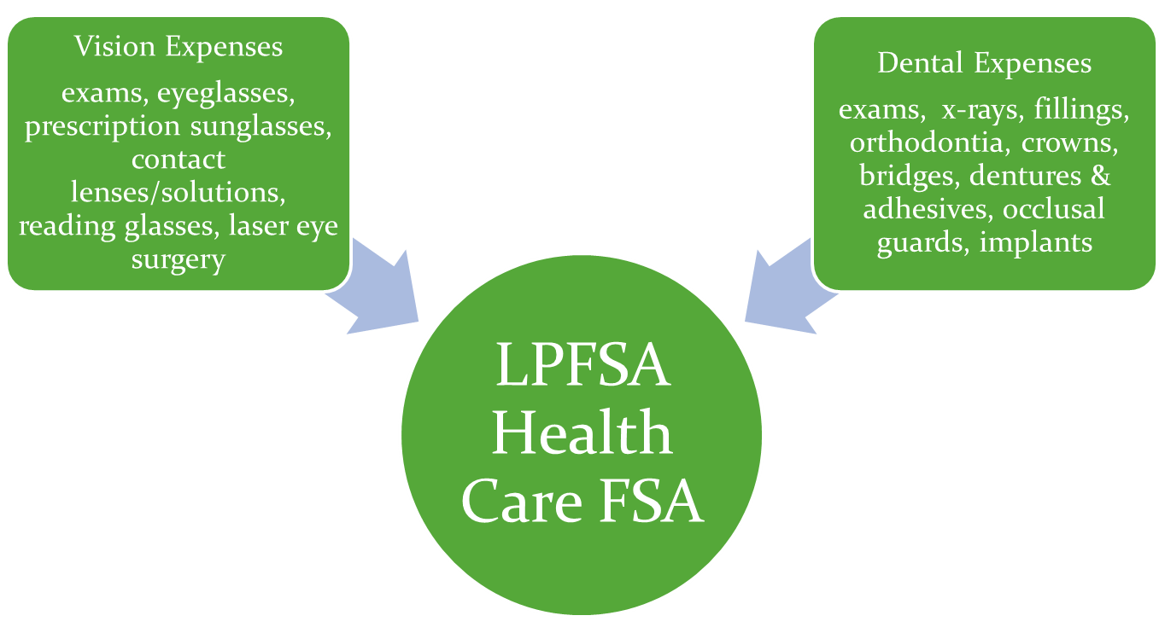
Limited-Purpose Health Care FSA – up to $3,300
Limited-Purpose FSA
HSA Compatible
for Vision and Dental expenses only

Slide 5
Dependent Care FSA – up to $7,500*
Dependent Care FSA
Dependent Care FSA
Babysitting while you work
Preschool or nursery school for young children
Before school or after school care
Day camps
For children under age 13
For child age 13+ or adult if not capable of self-care
*limit is half the amount if married and filing separate income tax returns

Slide 6

Grace Period
State of Missouri employees have a 2.5-month grace period to use the funds from the prior year. All funds not used by the end of the grace period are forfeited back to the State of Missouri.
The grace period applies to all of the Flexible Spending Accounts.
Expenses must be:
Incurred through March 15, 2027
Submitted by April 15, 2027

Slide 7
New hires enroll through SEBES within 31 days of their hire date.
Enrollment
You must enroll to keep your cafeteria plan account.
Prior elections do not roll over year-to-year.
Open Enrollment Period
October 1 - December 1
Enroll through MyMCHCP or directly through mocafe.com.
You will automatically be enrolled into Premium Only, unless you opt out.

Slide 8

Fees
Enrolling in one or more FSAs
Premium Only Participation
$2.60/month
$0.24/month
*The Premium Only Participation fee is waived if you enroll in an FSA.
*Participants will be charged a $4/month fee if not signed up for direct deposit.

Slide 9
Multiple Claim Filing Options
Option | Description
Mobile App | Snap picture of documentation and submit via the app
Online | Scan image of documentation and submit online
ASIFlex Card | Pay health care provider at point of service/sale; keep documentation and submit upon request
FSA Store Cardless Pay | Sign into ASIFlex account, and shop FSA Store. No credit or debit card needed; ASIFlex pays FSAStore from your account
Recurring Direct Pay | Sign up online to set up recurring payments to daycare provider
Automatic Reimbursement | Complete claim form to request automatic reimbursements for dependent care
Toll-free Fax | Complete claim form and fax to ASIFlex
USPS Mail | Complete claim form and mail to ASIFlex

Slide 10
MoCafe Online Resources (www.mocafe.com)
From the main site, you can:
View extensive eligible/ineligible expense listing
Access FSA Store with thousands of eligible FSA products
Read Frequently Asked Questions
Use the Expense Estimator & Tax Savings Calculator
View Educational videos
Find ASIFlex Card information
Access IRS Forms & Publications
In your FSA Participant Portal, you can:
Review your account details
Read secure messages sent to you
Manage your personal settings
Submit claims
Schedule a recurring direct payment
Shop FSA Store using Cardless Pay

Slide 11
Contact Us
Online: www.mocafe.com
Email: asi@asiflex.com
Phone: 800.659.3035
TTY Users: Dial 711
Live chat: Sign into your online account
Address: PO Box 6044
Columbia, MO 65203
Hours: 7 a.m. to 7 p.m. Monday through Friday
9 a.m. to 1 p.m. on Saturday

